Slide 1
MY TRIP
By: Sidney Cairo

Slide 2
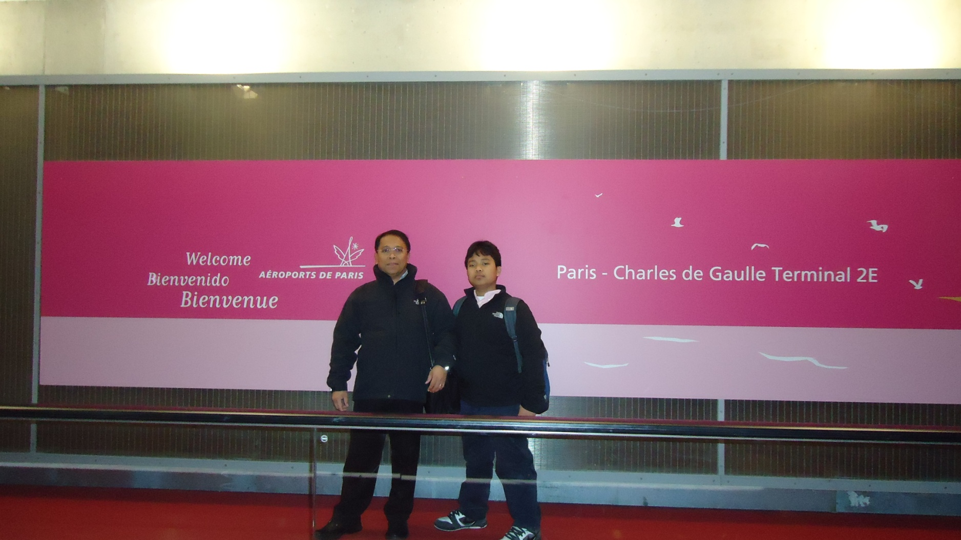
Arrival at CDG airport: Paris, France(without our luggage.)

Slide 3
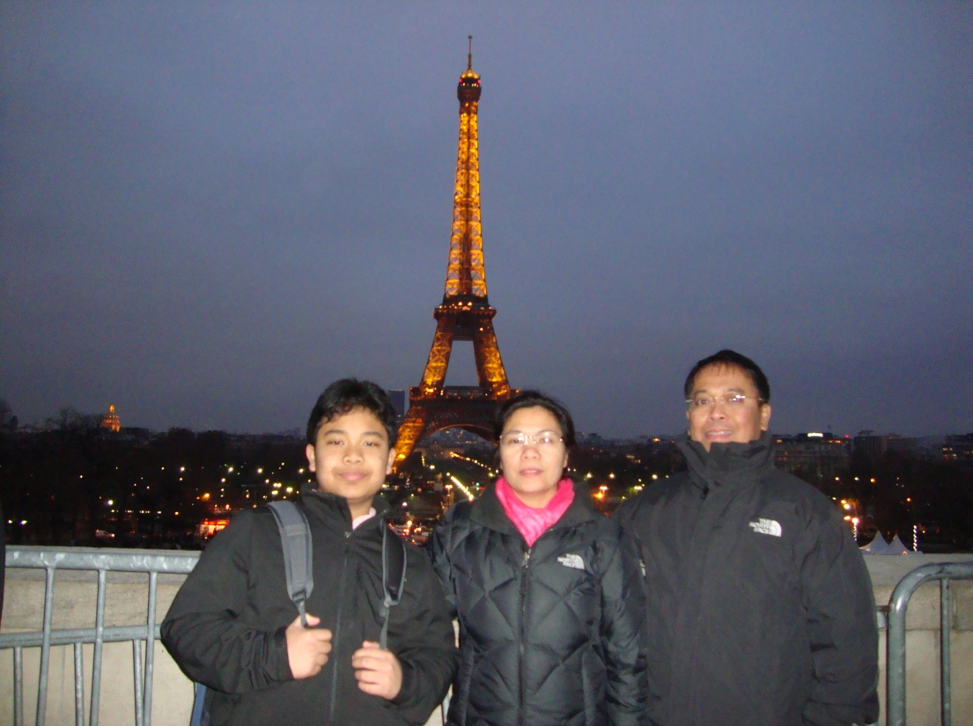
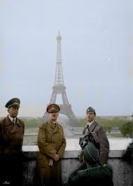
My family and I at the Eiffel tower. Standing at pretty much the same place a famous figure stood 70 years ago…..

Slide 4
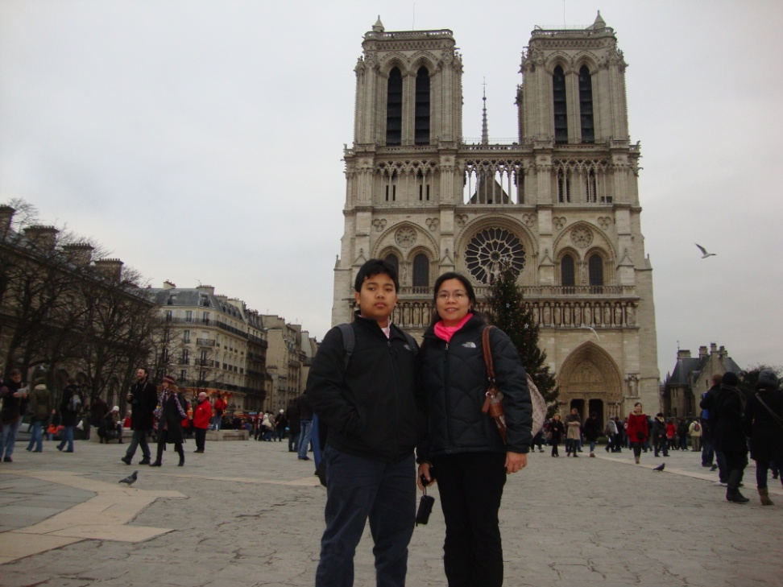
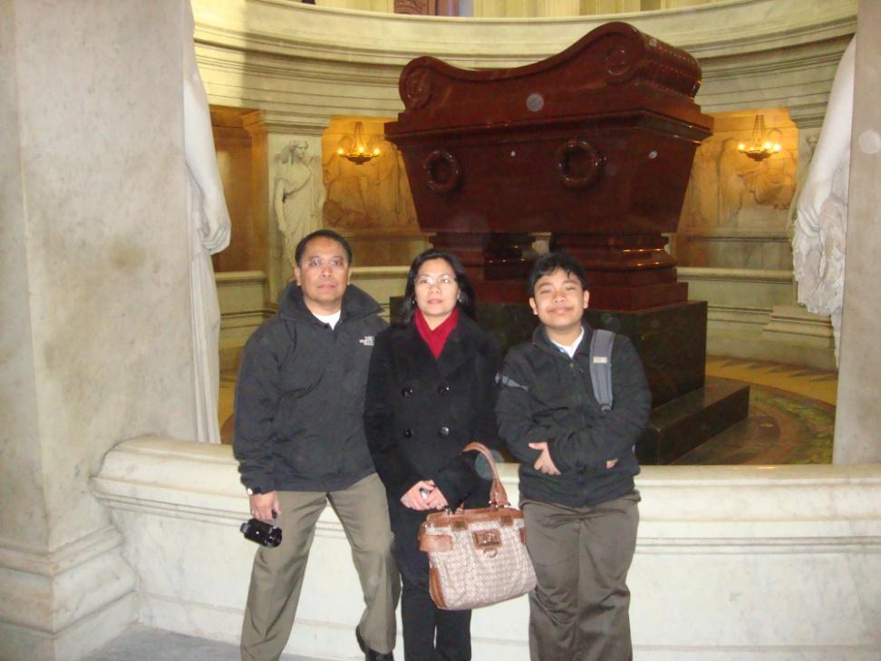
My family and I at Notre Dame cathedral and at Napoleon's tomb.

Slide 5
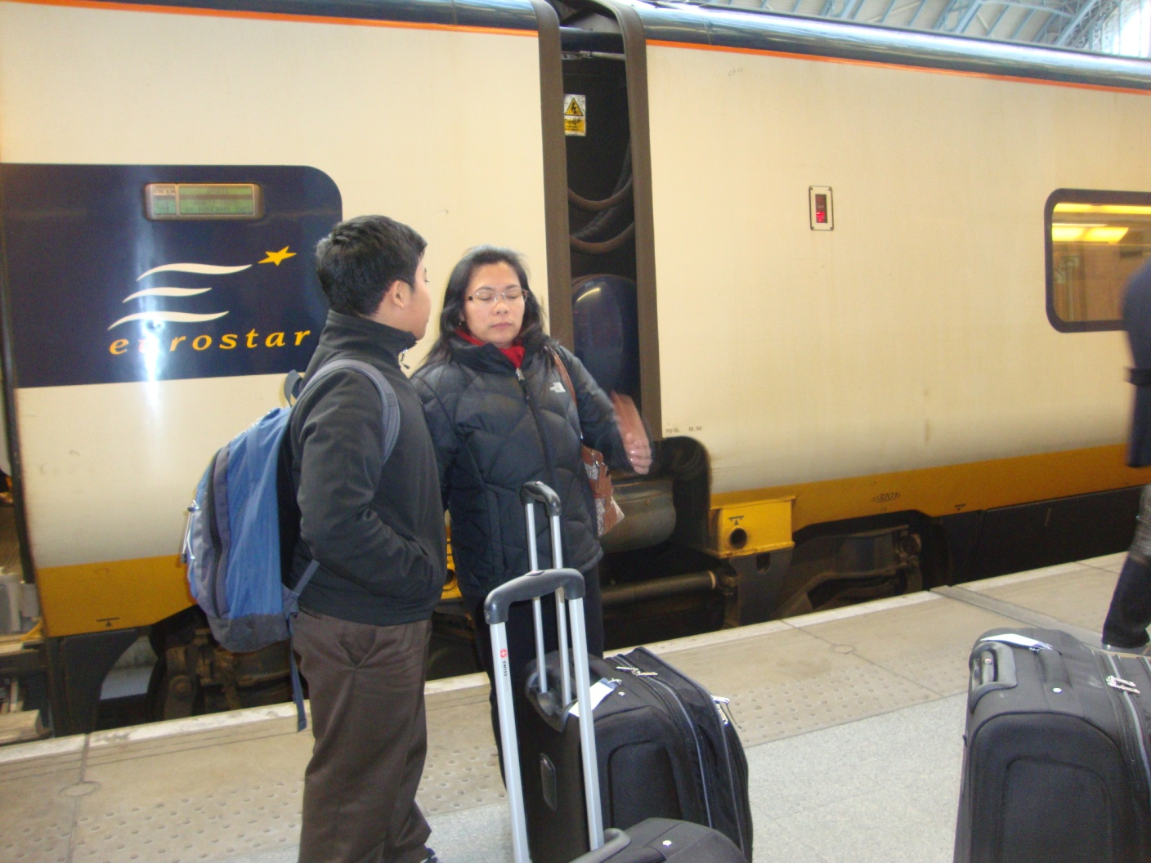
My family and I boarding a Eurostar train to England trough the English channel.

Slide 6
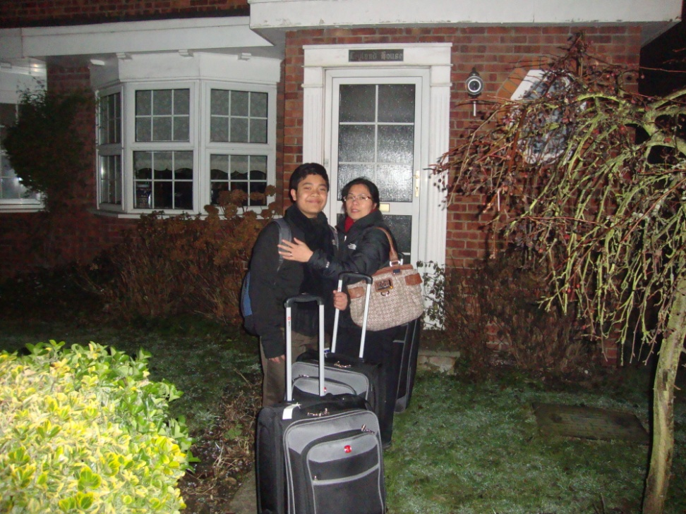
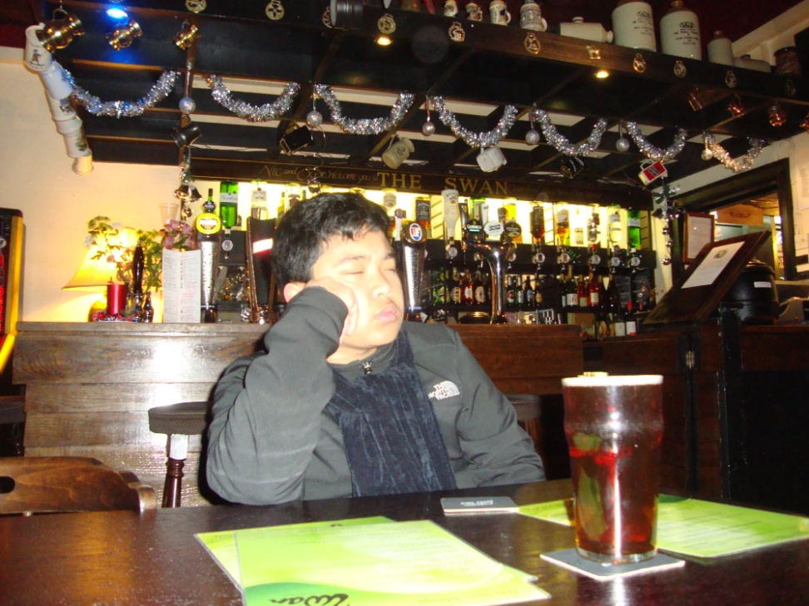
We arrived at my aunt’s house too early.( they were not home yet. So we went to the pub(bar). I got ‘lemonade’(7up)

Slide 7
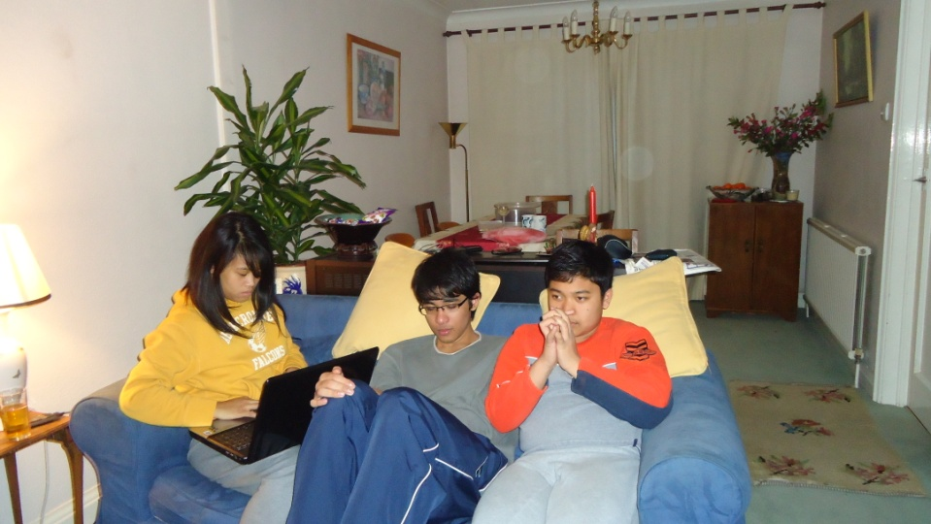
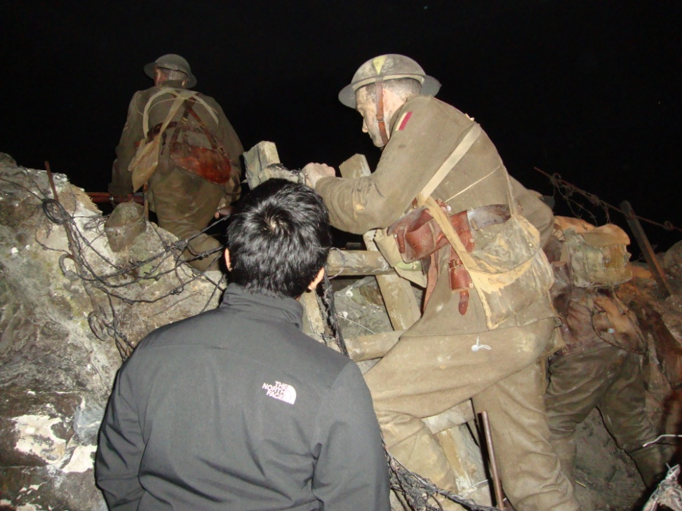
Our first 3 days in England were nice. Then we got stranded the last 3 days. The reason: 1 cm of snow. I’m dead serious…
Day 1-3 : Travelling around London.
Day 3-6 : Stranded in Edenbridge, Kent, England.

Slide 8
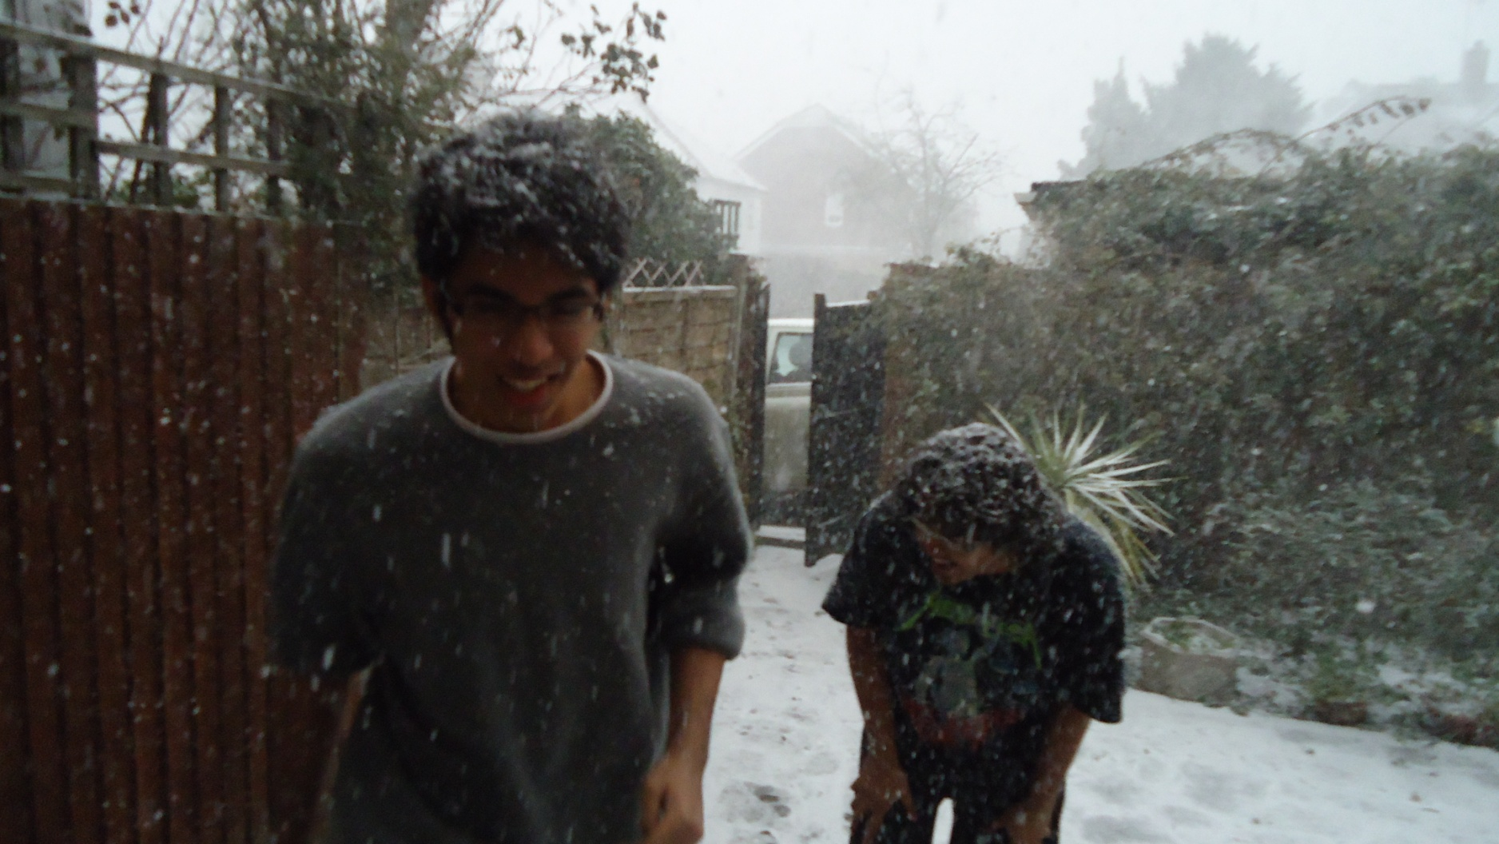
So my 2 cousins from Singapore bored and thinking it was not cold outside, decided to do this.

Slide 9
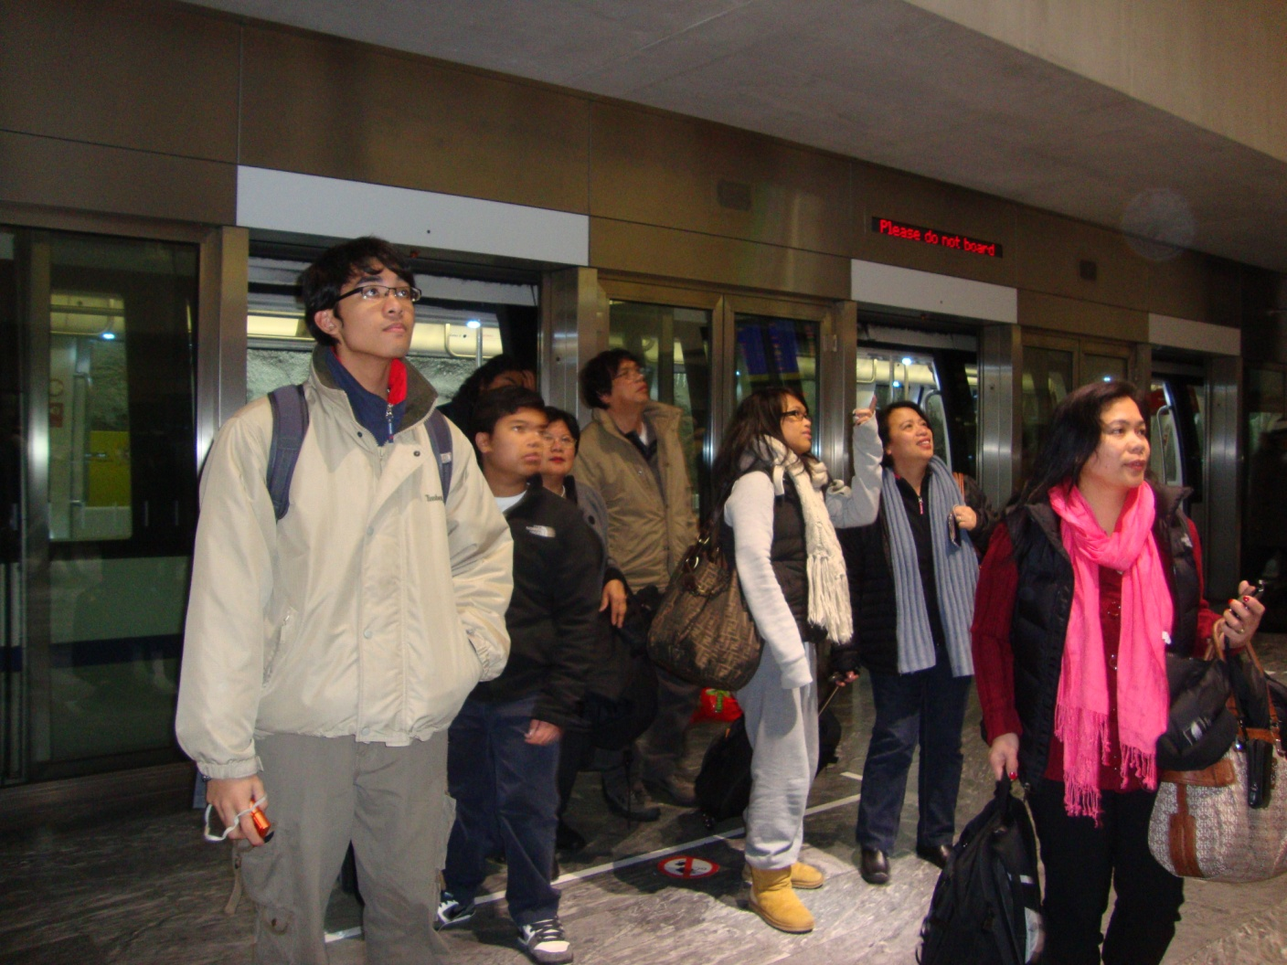
The next day we got stranded at Gatwick airport waiting for our flight to Zurich, Switzerland. But finally made it.

Slide 10
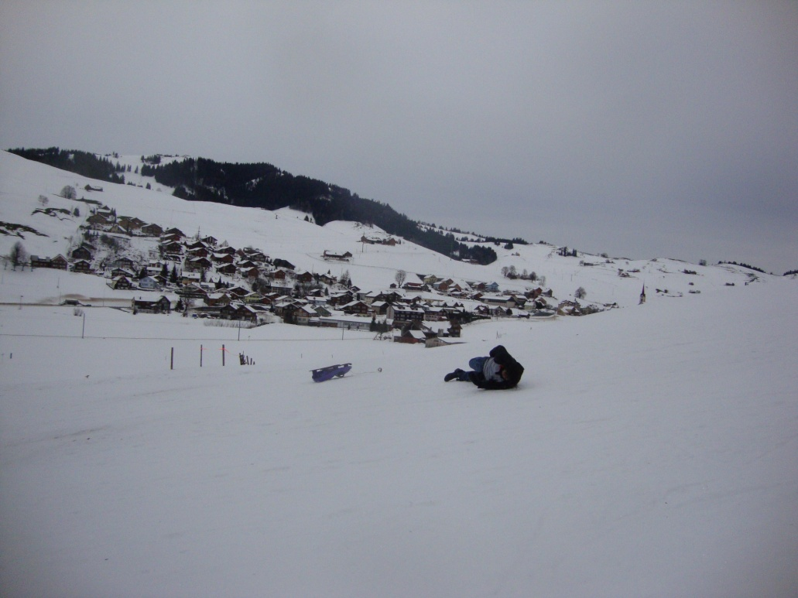
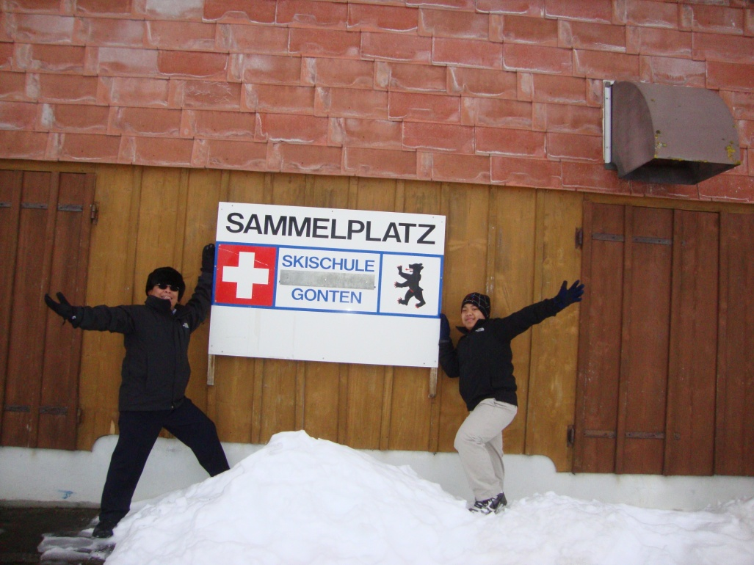
My cousins from Singapore also went sledding. The sled they were equipped with were a little to small for them. Meanwhile my dad and I were having a photo shoot.

Slide 11
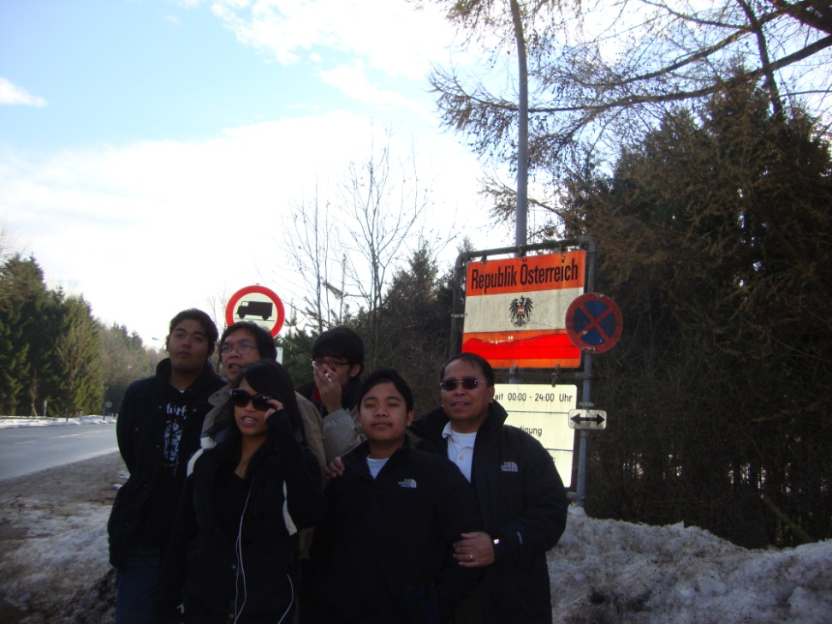
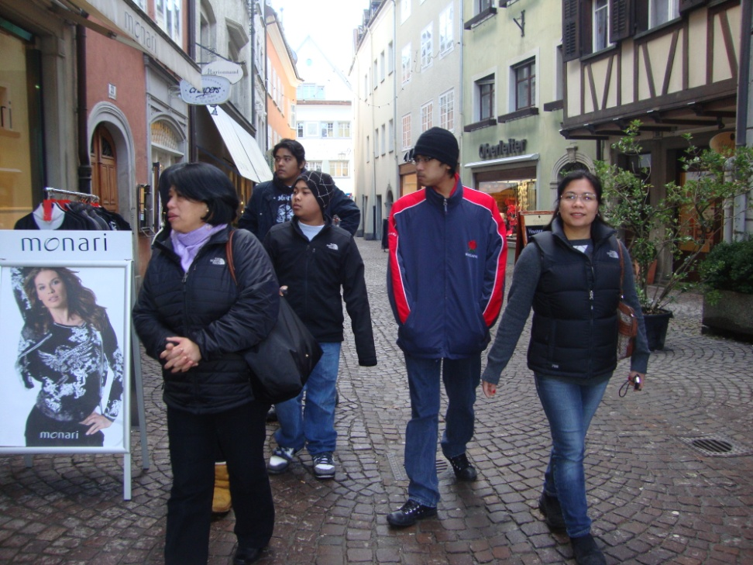
We also went to Austria!

Slide 12
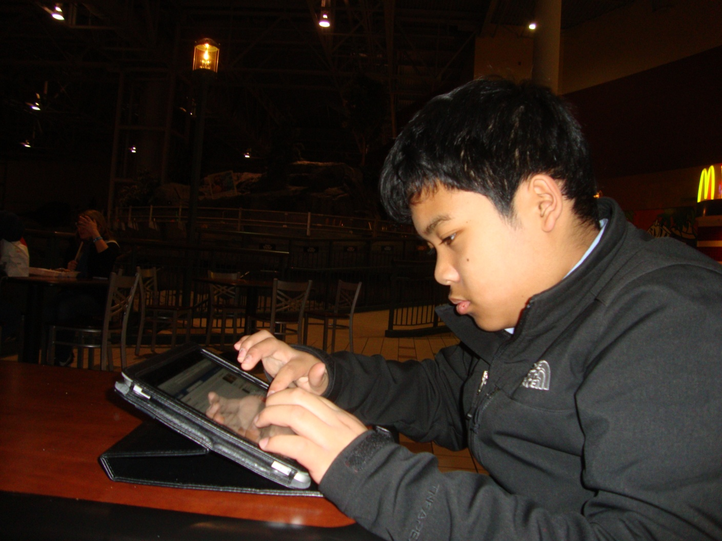
It was time to say Bye and head back home. We were scheduled to stay in Minneapolis for 5 hours. But we left 20 hours later the next day. Here is the story…

Slide 13
Why we got stranded at Minneapolis
Main reason: Planes not working.
How many planes did we board: 4
So that means people got mad.
The staff checked after we boarded, not before.
What did we get back: Nothing
What made most people happy in the end: Booze (alcohol). I'm serious.

Slide 14
THE END

